Slide 1
EL-Serag
A literacy platform for people with special needs

Slide 2


Introduced from Luxor University
Faculty of Computing and Informatics
Supervised by: Dr. Hussein El-shafie

Slide 3
Team Members
Mohamed AbdElrahman Elkhlawy
Amina Younis Mohammed
Norhan Nageh Alabad
Team Leader Responsible for Project Documentation and related Tasks
Flutter Developer problem solving skilled
Intermediate machine learning Engineer
Full-Stack Flutter Developer
excels in API and Firebase development

Slide 4
Team Members
Manar Hussein Mohamed
Omar Mohamed Elhassan
Sarah Nabil Kamel
Flutter Developer and experienced Front-end web Development (Html-CSS)
Full Stack web Developer and UI/UX Designer
Full Stack web Developer with react Framework ,PHP and MySQL

Slide 5
"Literacy is the key that unlocks doors for every mind, and for those with special needs, it is the golden key that transforms challenges into triumphs, opening the way to boundless possibilities and empowering every individual to write their own story of success."

Slide 6
01
TABLE OF CONTENTS
02
03
Abstract and Description
Project Overview: Exploring Ideas, Methods, and Impact
Prototype Preview
Cover of UI Design
WireFrames
Visualizing Success: Navigating the Project's Blueprint with Wireframes

Slide 7
01
Abstract and Description

Slide 8
Abstract First Section
First, we want to know more about the people with special needs.People with special needs encompass a diverse and heterogeneous group of individuals who face various physical, intellectual, sensory, or developmental challenges that may require additional support and accommodation. These challenges can result from conditions such as autism, Down syndrome, cerebral palsy, ADHD, dyslexia, visual or hearing impairments, and more. Special needs individuals often require tailored educational, social, and healthcare services to meet their unique requirements and maximize their potential for independent living and participation in society.

Slide 9
Abstract Second Section
Second, we want to know more about the kinds of disabilities.Disabilities encompass a broad spectrum of conditions and challenges that can affect an individual's physical, cognitive, sensory, or emotional functioning. These disabilities are often categorized into various types to better understand and address the specific needs of individuals. Some common types of disabilities include physical disabilities, which may involve mobility impairments, paralysis, or chronic health conditions. Cognitive disabilities encompass intellectual and developmental challenges such as autism, Down syndrome, and learning disabilities like dyslexia. Sensory disabilities include visual impairments, hearing impairments, and speech or communication disorders. Emotional and mental health disabilities cover conditions like depression, anxiety, and bipolar disorder.

Slide 10
Blindness, a sensory disability, creates unique challenges related to access to information, communication, mobility, and independence.Focusing on blindness as the primary disability in our project represents a significant step towards fostering inclusivity and empowerment for individuals with visual impairments.
In our project, we aim to develop a literacy platform that caters specifically to the needs of blind individuals. This entails creating accessible digital content, leveraging assistive technologies, and adopting inclusive design principles to ensure that blind users can acquire and enhance their literacy skills effectively. By prioritizing blindness in our project, we contribute to the broader mission of making education and information accessible to all, regardless of their visual abilities.Our project holds the potential to transform the lives of blind individuals, empowering them with the knowledge and skills necessary for personal growth, societal participation, and increased opportunities.

Slide 11
02
Prototype Preview

Slide 12
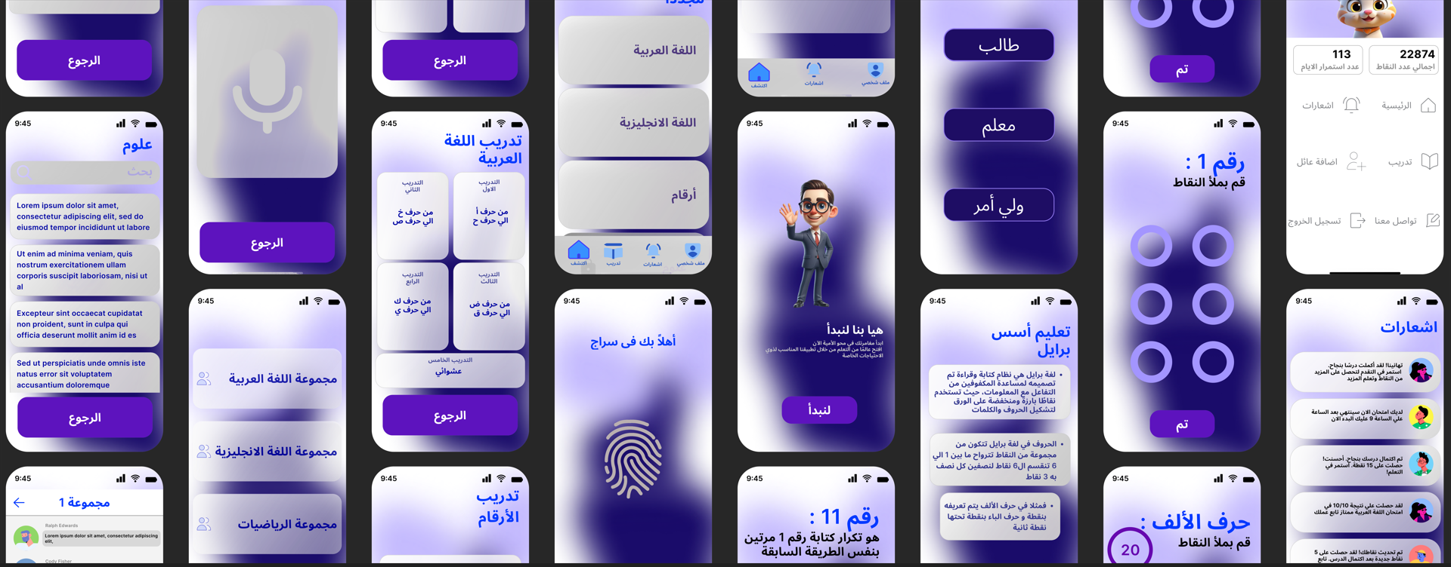
Preview
UI Design For View
Click here
For better Quality for Preview
Click here

Slide 13
03
WireFrames
03

Slide 14
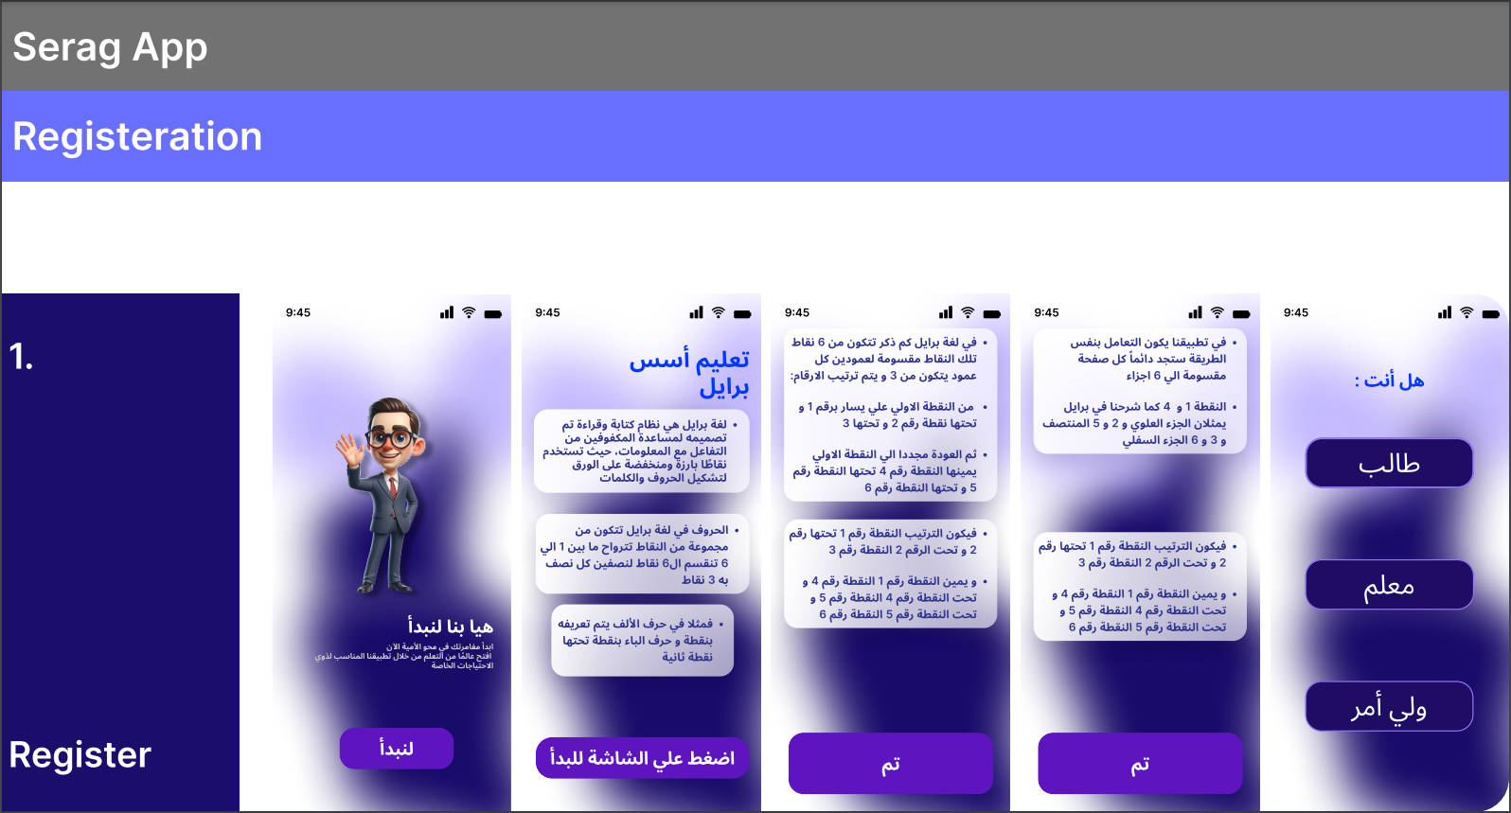
1. Register Section
This section covers:
Brille instructions to know how to use the app
Role specifier so you can log to app uses
For Better Quality Click here

Slide 15
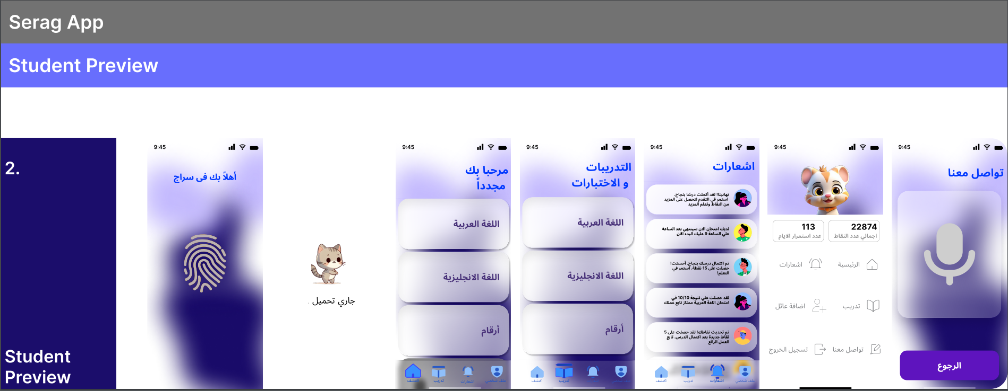
2. Student Preview Section
This section covers:
HomePage for Lessons and Exercises
Notifications and contact us
Profile of the student that contains the total points and days streak
For Better Quality Click here

Slide 16
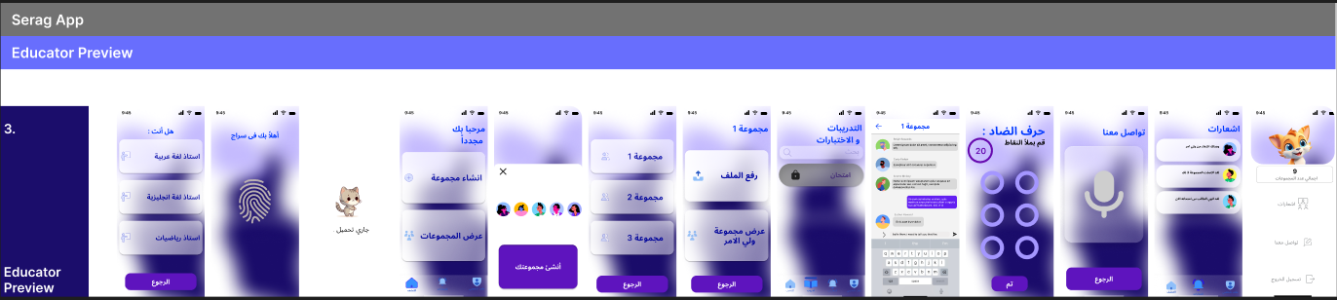
3. Educator Preview Section
This section covers:
The Educator category and fingerprint to log in
Group Creation and view Groups
Upload courses and view CareGiver chat
Notifications and contact us
Profile of the Educator that contains the total groups that he owns
For Better Quality Click here

Slide 17
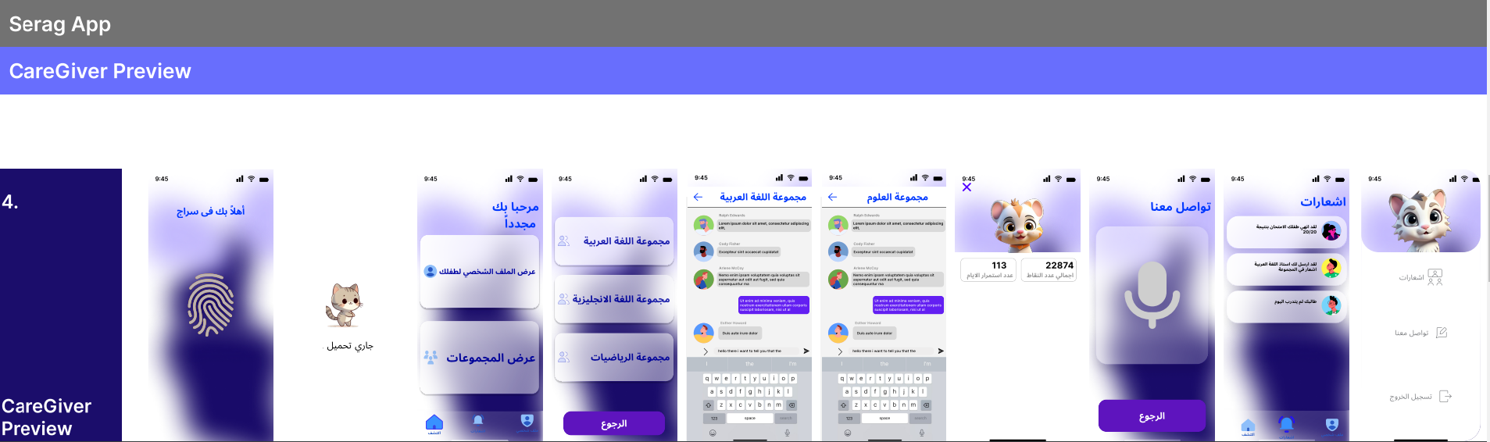
4. CareGiver Preview Section
This section covers:
fingerprint to log in
view Student profile so he can know its progress
Group Chats for student lessons
Notifications and contact us
Profile of the Caregiver
For Better Quality Click here

Slide 18
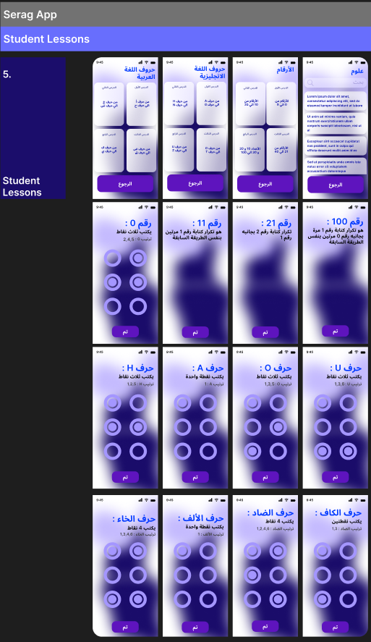
5. Student Lessons Section
This section covers:
Lessons for each course the student added
Explanation parts
For Better Quality Click here

Slide 19
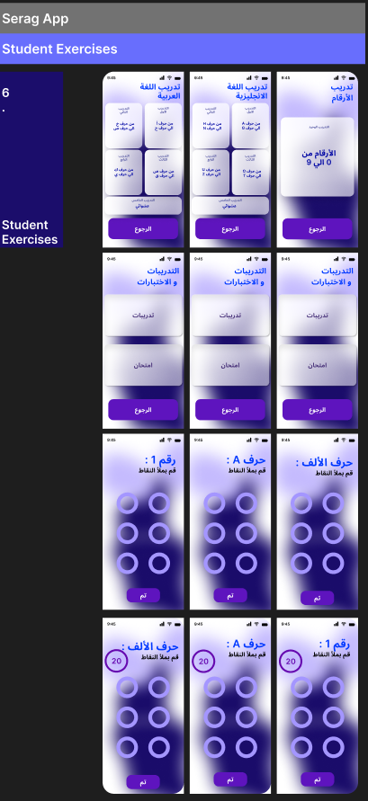
6. Student Exercises Section
This section covers:
Exercises for each course the student added
Training and Examples
Quiz Screens
For Better Quality Click here

